Slide 1
A core Course on Modeling
Introduction to Modeling
0LAB0 0LBB0 0LCB0 0LDB0
c.w.a.m.v.overveld@tue.nl
v.a.j.borghuis@tue.nl
S.18

Slide 2
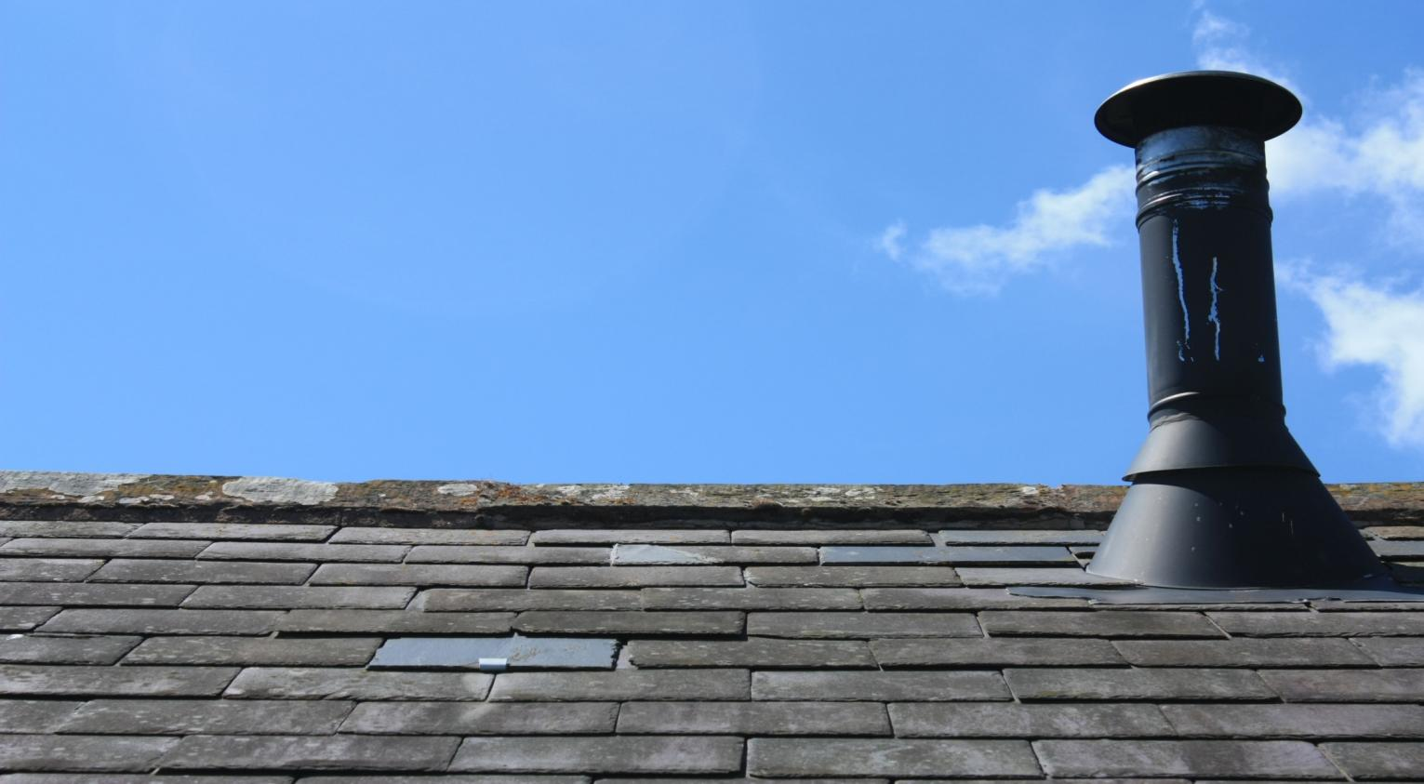
Example 2:
http://www.sxc.hu/photo/1361109
“How many chimney sweepers
work in Eindhoven?”
Notes:
2

Slide 3
Example 2:
http://www.sxc.hu/photo/1361109
“How many chimney sweepers
work in Eindhoven?”
QUIZ
First try to find the answer yourself in the same way as with the detergent problem.
Notes:
3

Slide 4
relations
dimensions
assumptions
todo
nrChSwIE =
nrChIE * nrSwPCh
[Sw / E] =
[Ch / E] * [SW / Ch]
Eindhoven ch.-sweepers sweep Eindhoven chimneys only
nrChSwIE
nrChIE
nrSwPCh
nrChPFam
nrFamIE
nrPIE
nrPPFam
nrChIE =
nrChPFam * nrFamIE
[Ch / E] =
[Ch / Fam] * [Fam / E]
ch.-sweepers sweep only chimneys on family houses
nrFamIE =
nrPIE / nrPPFam
[Fam / E] =
[P / E] / [P / Fam]
nrPPFam is the same everywhere (does not depend on ‘Eindhoven’)
nrPIE = 250000 [P]
common knowledge
nrPPFam = 2.2 ± 0.2 [P/Fam]
public domain
nrChPFam (= 1/nrFamPCh) =0.1±0.02 [Ch/Fam]
wisdom of the crowds
Sw=sweeper; Ch=chimney;E=Eindhoven;Fam=Family;P=people;Se=Service;
Notes:
4

Slide 5
relations
dimensions
assumptions
todo
nrSwPCh =
nrChSwIE
nrChIE
nrSwPCh
nrChPFam
nrFamIE
nrPIE
Sw=sweeper; Ch=chimney;E=Eindhoven;Fam=Family;P=people;Se=Service;
Notes:
5

Slide 6
QUIZ
To find an expression for the number of chimney sweepers per chimney, try to relate the offered capacity of chimney sweepers to the required capacity of chimneys.
What is the expression for nrSwPCh?
relations
dimensions
assumptions
todo
nrSwPCh =
nrChSwIE
nrChIE
nrSwPCh
nrChPFam
nrFamIE
nrPIE
Sw=sweeper; Ch=chimney;E=Eindhoven;Fam=Family;P=people;Se=Service;
Notes:
6

Slide 7
relations
dimensions
assumptions
todo
nrSwPSe * nrSePCh
relate sweeper’s capacity to chimney’s need
nrChSwIE
nrChIE
nrSwPCh
nrChPFam
nrFamIE
nrPIE
nrPPFam
nrSwPSe
nrSePCh
timeP1Se
timeP1Sw
nrSwPCh =
[Sw / Ch] =
[Sw*year/Se] * [Se/(Ch*year)]
nrSwPSe =
timeP1Se / timeP1Sw
[Sw * year / Se] =
[hour / Se] / [hour / (Sw*year)]
assume average times (i.e., no season influences etc.)
timeP1Se = 2±0.25 hour / Se
wisdom of the crowds
timeP1Sw = 1200±100 hour / Sw * year)
work year = 1600 hours
nrSePCh = 1 Se /( Ch * year)
insurance requirement
todo list is empty → model is ready
Sw=sweeper; Ch=chimney;E=Eindhoven;Fam=Family;P=people;Se=Service;
Notes:
7

Slide 8
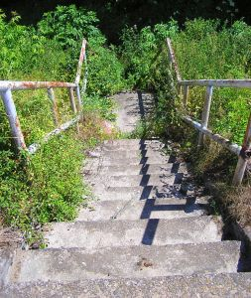
QUIZ
Why again did we compute the number of chimney sweepers in Eindhoven?
http://www.sxc.hu/browse.phtml?f=download&id=587687
Notes:
8

Slide 9
Where does this lead to?
Nowhere
...since we formulated no purpose!
http://www.sxc.hu/browse.phtml?f=download&id=587687
Notes:
9

Slide 10
What purposes could we think of?
QUIZ
Give at least three different reasons why we could be interested in the number of chimney sweepers in Eindhoven?
Notes:
10
You may try to find examples for other purposes of the chimney sweepers model (think of analysing, predicting and unifying)

Slide 11
What purposes could we think of: e.g. verification
are there at least 200 Chimney Sweepers so that we can begin a professional journal?
so: we only need to know if NrChSwIE > 300
Notes:
11
You may try to find examples for other purposes of the chimney sweepers model (think of analysing, predicting and unifying)

Slide 12
What purposes could we think of: e.g. verification
are there less than 50 Chimney Sweepers so that we can have next year’s ChSw convention meeting in the Restaurant ‘the Swinging Sweeper?’
so: we only need to know if NrChSwIE <50
Notes:
12

Slide 13
What purposes could we think of: e.g. verification
are there about as many Chimney Sweepers as there are Sewer Cleaners (=23) so that we can form efficient ‘Chimney and Sewage Control and Service Units’?
so: we only need to know if NrChSwIE is between 20 and 30
Notes:
13

Slide 14
What purposes could we think of:
… each purpose
poses different challenges
allows different approximations
Notes:
14

Slide 15
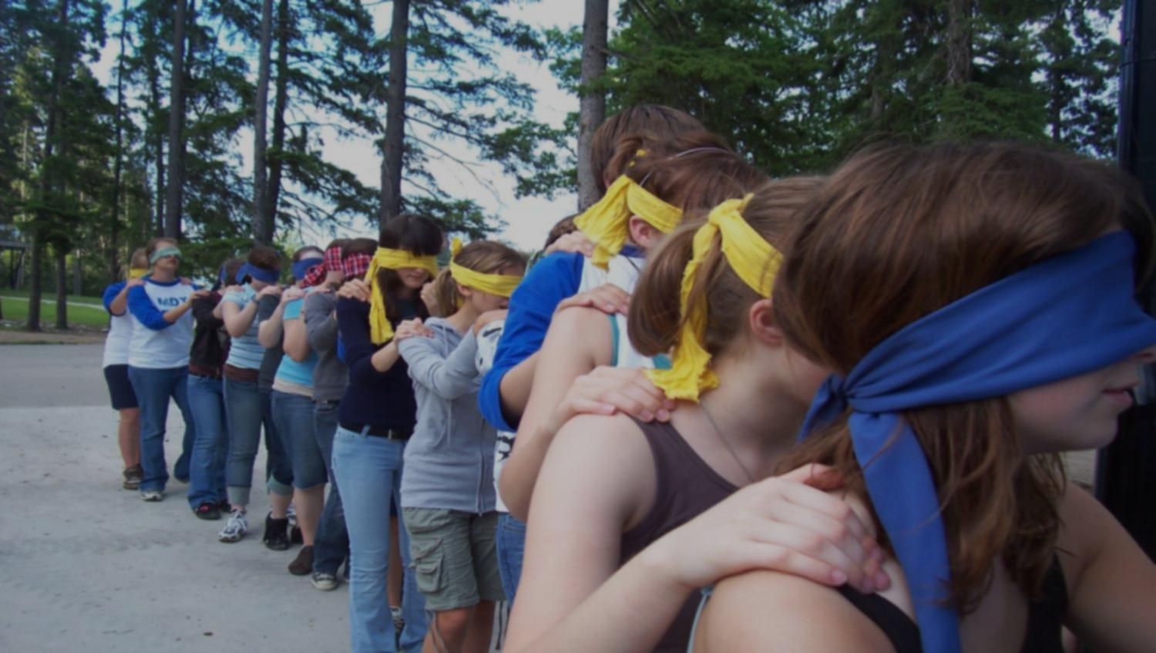
Can we trust the model? (elaborated in ch. 6)
Confront with the outcome of a second, independent model
http://www.sxc.hu/browse.phtml?f=download&id=836231
Notes:
15
How to trust models will be explained further in chapter 6.

Slide 16
Can we trust the model? (elaborated in ch. 6)
Confront with the outcome of a second, independent model
QUIZ
What other approaches can you think of to estimate the number of chimney sweepers in Eindhoven?
http://www.sxc.hu/photo/802363
Notes:
16

Slide 17
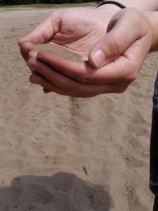
Can we trust the model? (elaborated in ch. 6)
Confront with the outcome of a second, independent model
How much soot and ashes
are disposed of by the municipal Ash & Soot Depot?
http://www.sxc.hu/photo/802363
Notes:
17

Slide 18
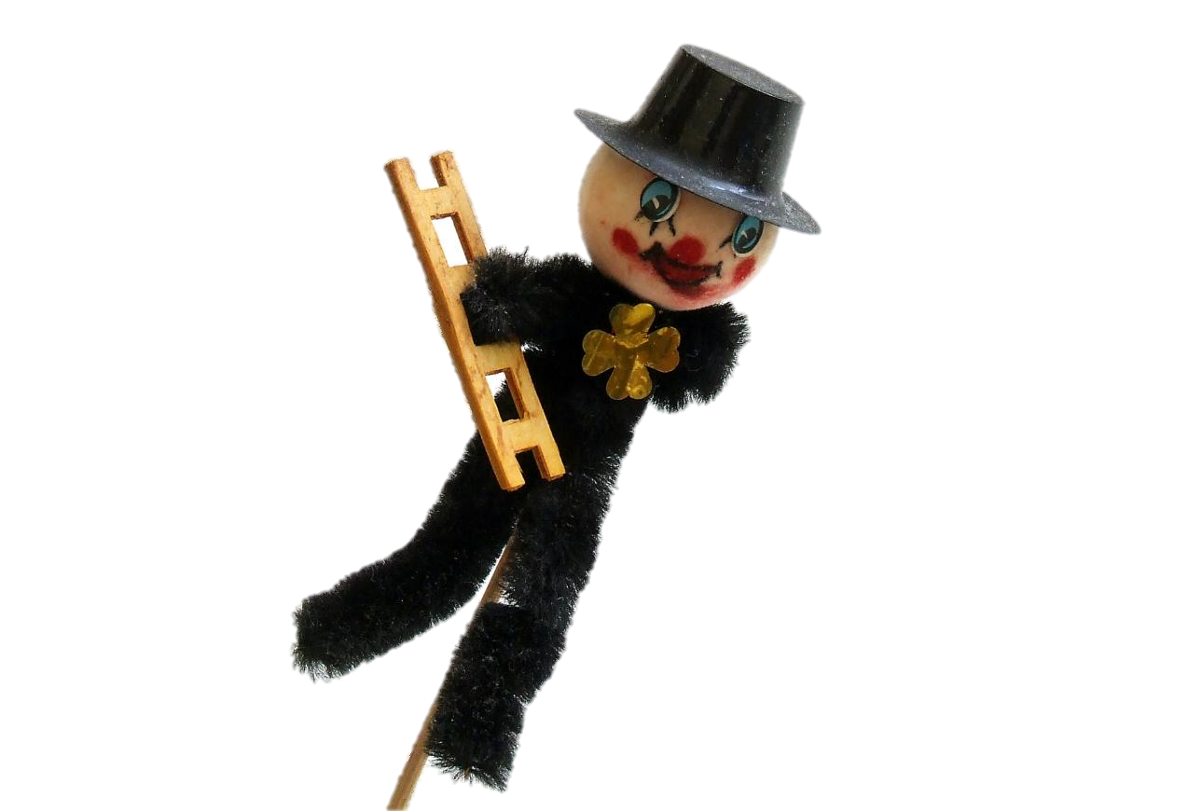
Can we trust the model? (elaborated in ch. 6)
Confront with the outcome of a second, independent model
http://www.sxc.hu/browse.phtml?f=download&id=811693
How often do you see a
chimney sweeper at work
(wisdom of the crowds)?
Notes:
18

Slide 19
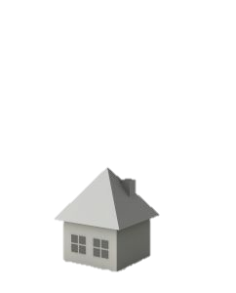
$
Can we trust the model? (elaborated in ch. 6)
$
http://www.sxc.hu/photo/1089075
Confront with the outcome of a second, independent model
$
$
$
$
$
$
$
$
How much money do people
in E. spend annually in
cleaning their chimneys?
check out a model for the later case:
Notes:
19

